Slide 1
The Classical Period (1750 - 1820)
Kenny Lim

Slide 2
Introduction
The classical style
The classical form
The first Viennese school
Notes:
How presentation will benefit audience: Adult learners are more interested in a subject if they know how or why it is important to them.
Presenter’s level of expertise in the subject: Briefly state your credentials in this area, or explain why participants should listen to you.

Slide 3
Classical Period
Known as the Age of enlightenment
Galileo Galilei (1564 -1642)
Sir Isaac Newton (1643 – 1727)
Voltaire (1694 – 1778)
Denis Diderot (1713 – 1784)

Slide 4
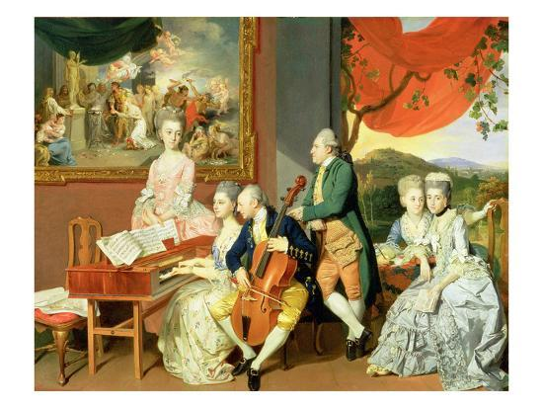
Notes:
As the century advance, people made more money
During the classical period, middle-class had a great influence on music.
Music scores, instruments and music lessons became vastly available.

Slide 5
The Classical Orchestra
A standard group of four sections: strings, woodwinds, brass, and percussions:
Strings: 1st violins, 2d violins, violas, cellos, double basses
Woodwinds: 2 flutes, 2 oboes, 2 clarinets, 2 bassoons
Brass: 2 French horns, 2 trumpets
Percussions: 2 timpani
Composers exploited the individual tone colors of orchestral instrument.

Slide 6
Characteristics of the Classical style
Contrast of Mood: Works will have great variety and contrast of mood, these changes may change gradually or suddenly
Rhythm: Flexible and has more variety of rhythmic patterns.
Texture: Classical music is basically homophonic. However, texture is treated flexibly.
Melody: Tuneful and easy to remember.
Dynamics and the Piano: Use of gradual dynamic change (Crescendo & Decrescendo); Terraced dynamics
The End of the Basso Continuo: Bye Bye Basso Continuo

Slide 7
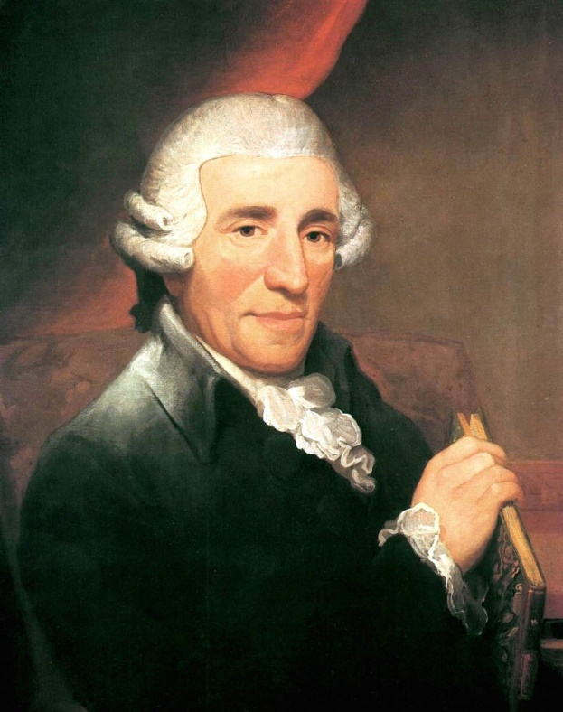
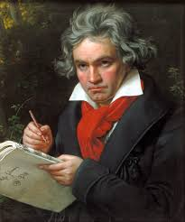
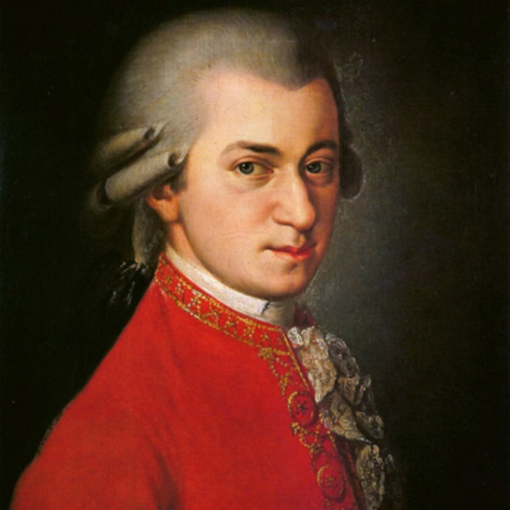
The first Viennese School
Haydn
Mozart
Beethoven

Slide 8
Joseph Haydn (1732 – 1809)
Born in a tiny Austrian village called Rohrau
Worked for Esterházy, the richest and most powerful of the Hungarian noble families
His music is robust and direct.
Master in developing themes: split them into small fragments to be repeated quickly by different instruments.
Used changes of texture, key, rhythm, dynamics and orchestration to create contrast of moods

Slide 9
Farewell symphony & Surprise Symphony
Symphony No.45 in F# minor “Farewell” (1772)
Symphony No.94 in G major “Surprise” (1791)

Slide 10
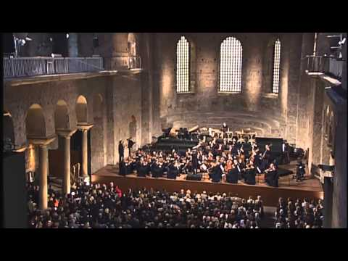

Slide 11
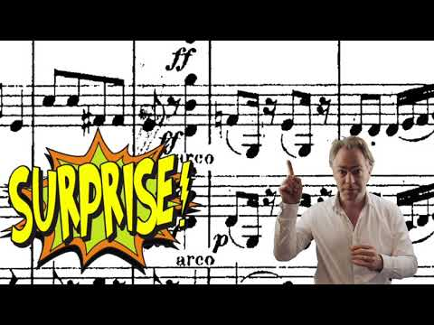

Slide 12
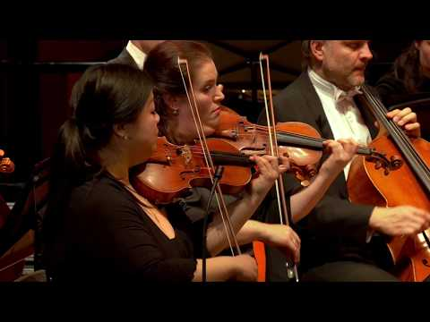
Farewell Symphony

Slide 13
Wolfgang Amadeus Mozart (1756 – 1791)
Born in Salzburg
A genius: composed his first song at 5
Master and used all the classical musical forms
His music conveys a feeling of ease, grace, and spontaneity, as well as balance, restraint, and perfect proportion.
Instrumental melodies seem to grow out of the human voice
Dramatic and lyrical
“must never offend the ear, but must please the hearer, or in other words, must never cease to be music.”

Slide 14
Don Giovanni (1787)
Music guide
Unique blend of comic and serious opera

Slide 15


Slide 16
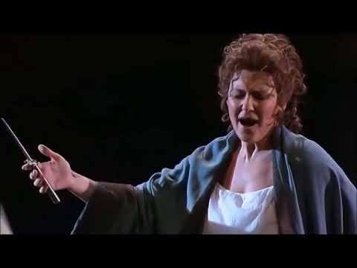

Slide 17


Slide 18
Ludwig van Beethoven (1770 – 1827)
Born in Bonn, Germany
Mozart said “Keep your eyes on him; someday he will give the world something to talk about.”
Studied with Haydn
His hearing weaken slowly, and was total deaf at towards his final years.

Slide 19
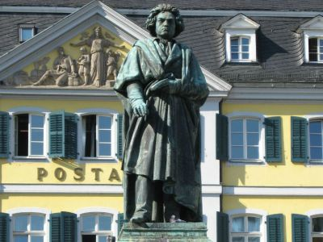
Directly reflected his powerful, tortured personality
Mostly used classical forms and techniques
Great tension and excitement are built up through syncopations and dissonances
Pitch and dynamics are greater
Accents and climaxes are ‘titanic’
Tiny rhythmic ideas are often repeated
Larger musical framework

Slide 20
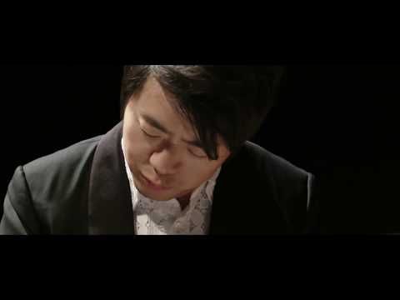

Slide 21
Symphony No.5/9
Symphony No.5 in C minor, Op.67 (1804)
Symphony No.9 in D minor, Op.125 (1822-1824)

Slide 22
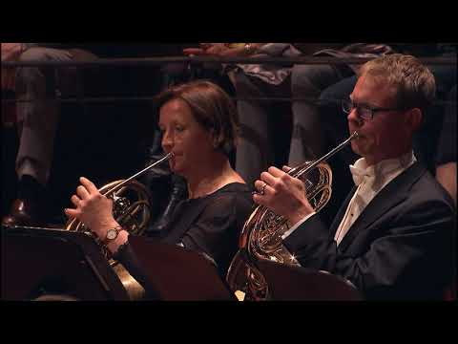

Slide 23
Forms
Classical Sonata
Classical Concerto
Classical Chamber Music
Classical Symphony

Slide 24
Sonata Forms
The term sonata form refers to the form of a single movement
Used in first movement of a classical symphony, sonata/ string quartet
There are three sections:
Exposition – where the themes are presented
Development – where the themes are treated in new ways
Recapitulation – where the themes return
These 3 main sections often followed by a concluding section -> Coda

Slide 25

A single sonata-form movement may be outlined as follows:
Exposition First theme in tonic (home) key Bridge containing modulation from home key to new key Second theme in new key Closing section in key of second theme
Development
New treatment of themes; modulations to different keys
Recapitulation
First theme in tonic key
Bridge in tonic key
Second theme in tonic key
Closing section in tonic key
Coda
In tonic key
Mozart Piano Sonata in C Major

Slide 26
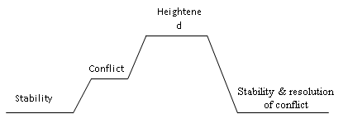
Exposition
Development
Recapitulation

Slide 27
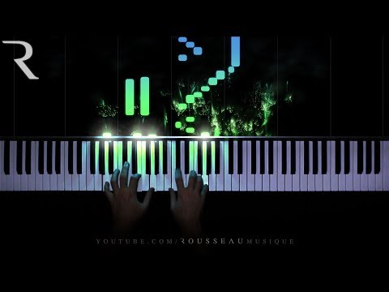

Slide 28
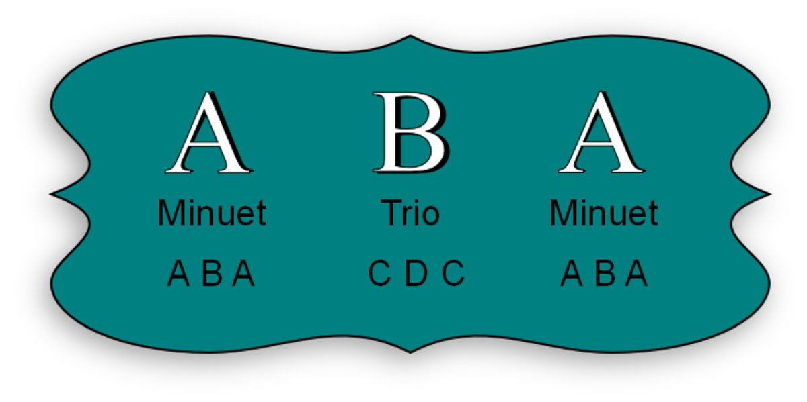
Minuet & Trio
Employed as 3rd movement of symphony, string quartet and other works
Simplest movement in symphony / string quartet
Minuet originated as a dance, but in a symphony and string quartet, minuet is for listening
Triple meter
In Moderate tempo
A-B-A form: Minuet (A) : a (repeated)-b-a’ (repeated) Trio (B) : c (repeated) –d-c’ (repeated) Minuet (A) : a-b-a’
Beethoven used scherzo to replace minuet movement
Similar as Minuet but move at a faster pace, generated more energy, rhythmic drive and humor.
Mozart Eine Kleine Nactmusik Minuet and Trio

Slide 29
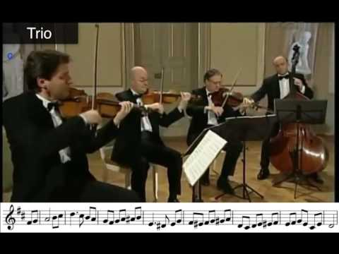

Slide 30
Rondo
Feature a tuneful main theme (A) which will return several times in alternation with other themes
Common pattern: A-B-A-C-A & A-B-A-C-A-B-A
Main theme (A) are usually lively, pleasing and simple to remember (In tonic key)
Can be used as independent movement or a movement in symphony, string quartet or sonata
Often combined with Sonata form to create Sonata-rondo
https://www.youtube.com/watch?v=VDiMuKaQL_A

Slide 31
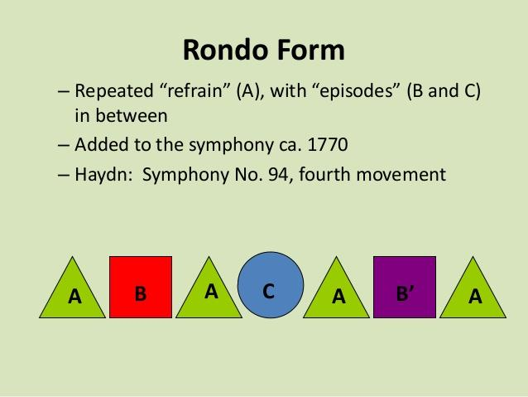

Slide 32


Slide 33
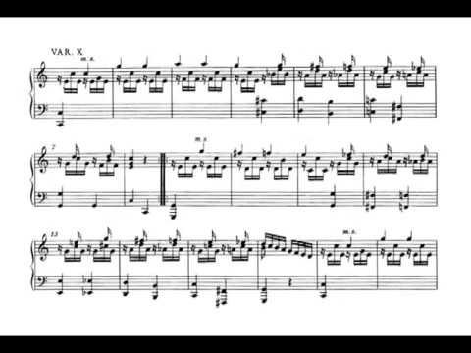
Theme and Variation
A-A’-A’’-A’’’-A’’’’ ETC.

Slide 34
Classical Symphony
An extended, ambitious composition for the orchestra.
1st movement: Fast, vigorous, dramatic (Sonata form)
2nd movement: Slow, lyrical
3rd movement: Dance-like, generally Minuet or Scherzo
4th movement: Brilliant, light or heroic, fast movement

Slide 35
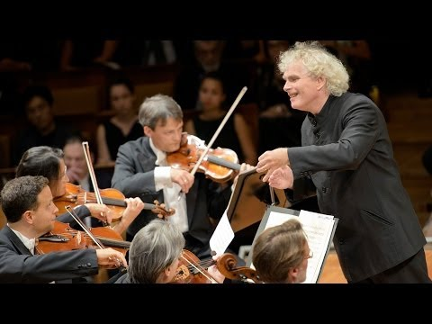
Mozart’s Symphony No.40

Slide 36
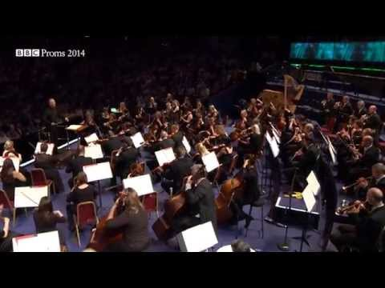
Beethoven’s Symphony No.3 “Eroica” 3rd movment

Slide 37
Classical Concerto
A THREE movement work featuring a soloist and orchestra
Lasts about 20 – 45 minutes long
Normally has cadenza section
1st movement: Fast (Sonata form: 2 expositions – orchestra and solo
2nd movement: Slow (Any form)
3rd movement: Fast (Quick rondo/ sonata rondo)
Beethoven Piano Concerto No.1 Cadenza

Slide 38
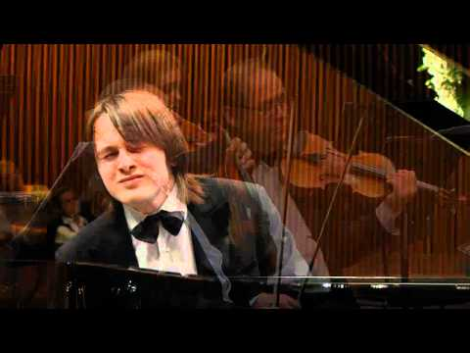

Slide 39
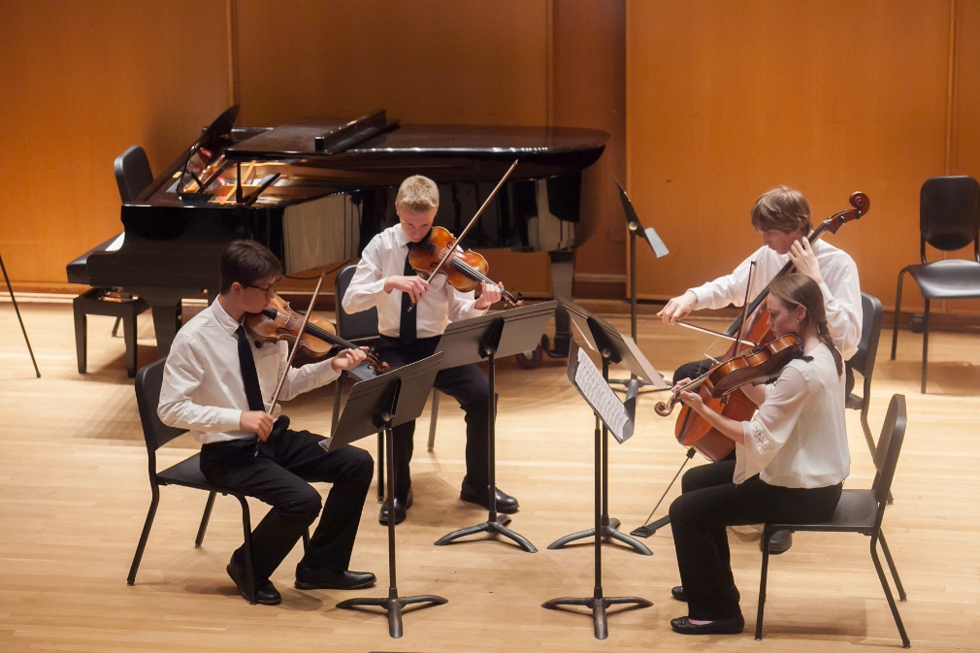
Classical Chamber Music
Designed for the intimate setting of a room (chamber) in a home or place
2 – 9 players
Most important form in classical chamber music is the string quartet ( 2 violins, 1 viola, 1 cello)
“The string quartet can be compared to a conversation among four lively, sensitive, and intelligent people.”

Slide 40
The string quartet consists of FOUR movements (1) fast, (2) slow, (3) minuet or scherzo, (4) fast.
The 2nd and 3rd movement is interchangeable
Other popular forms of classical chamber music are the sonata for violin and piano; piano trio; and the string quintet (2 violins, 2 violas, 1 cello)

Slide 41
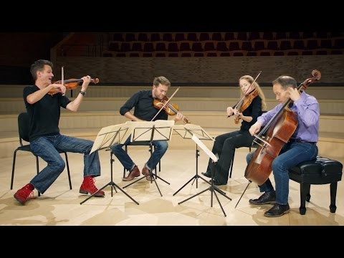

Slide 42
THE END

